Slide 1
MIS321
Project Management, SOW, Communication Plan, Risks & Issues

Slide 2
MIS Jobs

Slide 3
MIS Jobs
Technical
Tech-based Business
Business

Slide 4
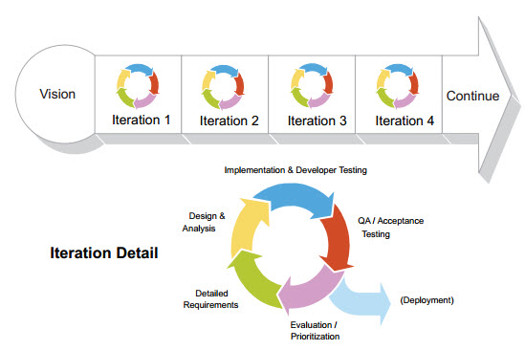
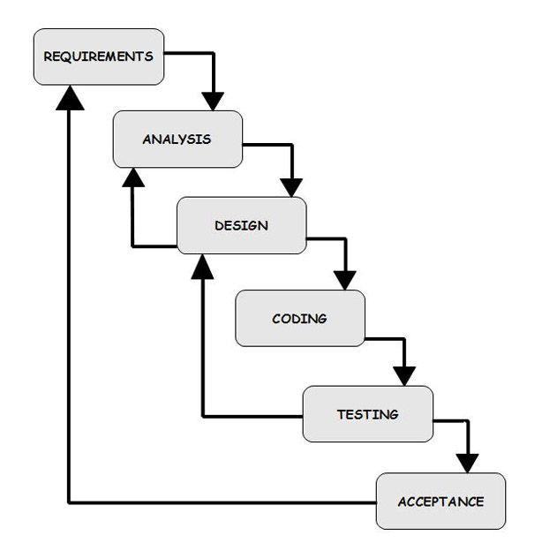
Roles within the Methodology: Developer
Developer

Slide 5
Roles within the Methodology: Business Analyst
Business Analyst

Slide 6
Roles within the Methodology: QA
Quality Assurance / Testers

Slide 7
Roles within the Methodology: Project Manager & Executives
Business Analyst
Project Manager
Developer
QA
Executives
Project Manager

Slide 8
Project Management

Slide 9
What is project management?
As defined by PMI, a project is a temporary endeavor undertaken to create a unique product, service, or result
A project has a defined beginning and end in time
Consequence means it must have bound scope and resources
Project management is the application of knowledge, skills, tools, and techniques to project activities to meet the project requirements
Not just an MIS or IT concept, but most technology roles are project-based

Slide 10
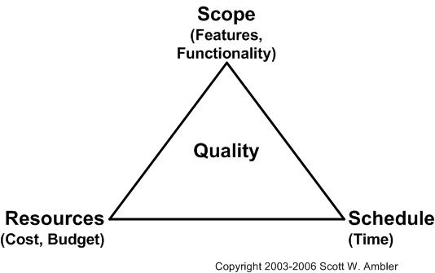
Project Management Triangle

Slide 11
Other PM Tasks
Often the lead of a team, managing tasks and people to ensure work gets done on time
Team lead vs Project manager
Removes roadblocks
Coordinates, facilitates, and recaps meetings
PMs don’t have the answers: they have to bring together the people with the answer, ask them the question, then communicate out the answer
Responsible for communicating status and health of project
Manages risks, issues, decisions needed & made

Slide 12




Primary Tools of PMs

Slide 13
Statement of Work

Slide 14
Statement Of Work
Primary purpose is to define and document scope
Who are we solving this for
What is the primary issue to be solved
What is the proposed solution (scope)
Describe the actual work to be accomplished
Epics or HLRs
What is not in (out of scope)
Edge cases
System interactions
What resources do we have access to
Who, what, and when
What
Why
Who
How

Slide 15
Statement Of Work
Defining Successes
Requires the problem to be solved is clearly stated
How is success measured
Use numbers!
Think project values first, specific features second
Focus on the impact to the organization
Should tie directly to the problem to be solved

Slide 16
Statement Of Work
Focus on risk mitigation communications in the SOW
How is status communicated to each level of the organization
How are risks communicated
What is the escalation process
Your full communication plan is outside the SOW

Slide 17
Statement of Work
General Tips
Remember your audience
Match their language: Terms, phrases, etc.
Tell the story: give the current state, solution, impact (before, during, after)
Avoid the thud factor
Focus on their challenges and the problem to be solved
Use an active voice
Use diagrams and charts as needed to convey complex information

Slide 18
Communication Plan

Slide 19
Communication Plan
Your plan should answer these questions:
What is being communicated?
To whom?
How often/at what cadence/prompted from what?
Through what medium?
Examples of topics to include in your plan:
Scheduling Meetings
New Risks/Issues
Scope changes
Stage Gate Completion

Slide 20
RAID Log: Risks, Actions, Issues, Decisions

Slide 21
RAID Log
Risk – a possible scenario that threatens the successful completion of the project on time, on budget, with full scope and high quality
Issue – a risk that has been realized
Action Items – tasks that are assigned as next steps, often resulting from a meeting. They follow the format Who/What/By When
Decision Tracker –
Decision Needed – outlines what decision is needed, by whom, by when. Should also include a high-level description of the impact and the recommended path
Decision Made – documents what decision was made, when, by whom

Slide 22
Communicating Risks & Issues
Risks
ID | Name | Description | Impact | Likelihood | Mitigation Strategy | Owner | Status
1 | Short Risk Name | Here are more details about the risk, why it exists, and what the impact could be to the project | High/Med/ Low | High/Med/ Low | What are you doing to mitigate this risk? | Name of Person | Open/ Closed
Issues
ID | Name | Description | Impact | Resolution Strategy | Owner | Status
1 | Short Issue Name | Here are more details about the issue, why it exists, and what the impact is to the project | High/Med/Low | What are you doing to resolve the issue? | Name of Person | Open/Closed

